Slide 1
The Handwash reminder band
Team Name : CHILARAI ( T-051)
Team members :
Akash chetia (leader)
Kunjal sarma
Reckon mazumdar

Slide 2
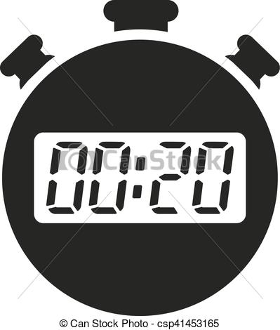

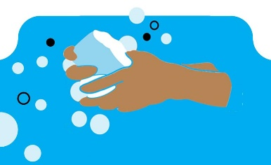
The Problem
People with memory loss problems or even common people in general often forget to maintain sanitization particularly hand washing. The two main mistakes that most people make in terms of hand washing are:
They do not wash their hands for complete 20 seconds as advised by the Centers for Disease Control and Prevention (CDC).
They often forget to wash their hands.

Slide 3
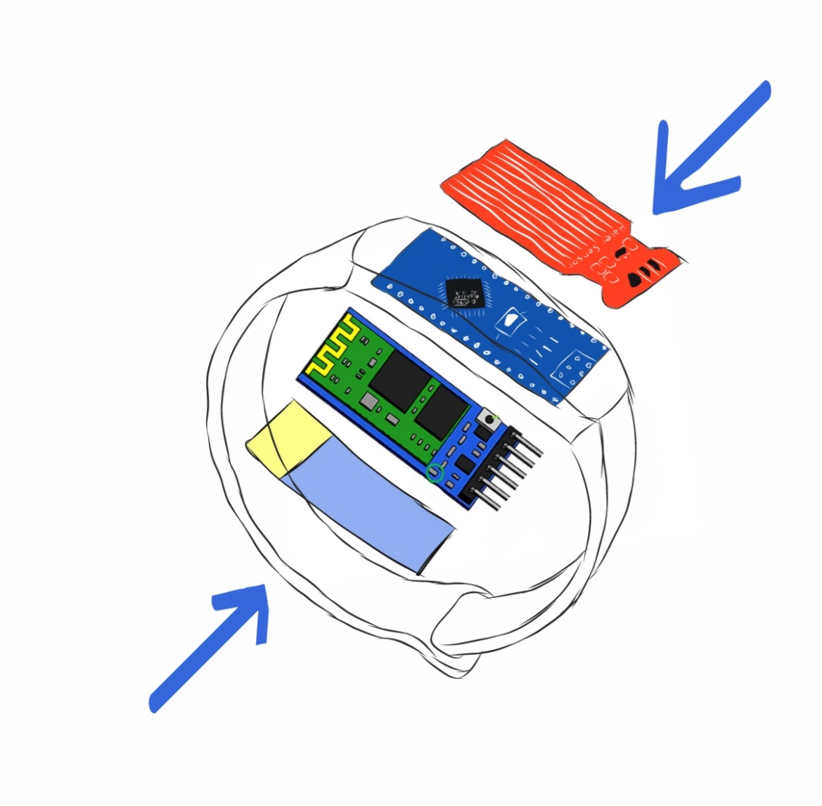
Our Solution
Handwash reminder band
It will give alerts to the user to wash his/her hands for at least 20secs.
It will notify the users to wash his/her hands after a certain interval of time by recording the previous handwashing data
Water sensor
Arduino
Bluetooth Module
Battery

Slide 4
Working

Slide 5
Project Requirements
Hardware technologies :
Water sensor ( to detect water)
Arduino (to connect all the components)
Bluetooth module (to connect the band and phone)
Battery for power
Software technologies :
Android app
Database (Firebase, Sqlite etc.)
Estimated project cost : Rs. 700

Slide 6
Existing or proposed solutions Vs our solution
Samsung company has come with an application which reminds the users about hand wash. But the user have to enter the hand washing data manually, whereas our application automatically keeps the track of the data with the help of the band.
Posters , ad’s and pictures of hand washing can be used to create awareness about handwashing.
But our solution is more optimum.
Limitations of our project:
1. Should be handled carefully
2. Should not be used while doing activities where the user have to touch water other than hand washing e.g. swimming, cooking etc.
Conclusion:
Thus we conclude that our handwash reminder band is affordable, effective and an easy to use solution to maintain the good practice of hand washing properly.

